Slide 1
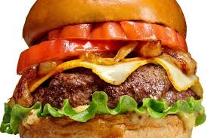
Deconstructed
Burger
By Loz McKenzie

Slide 2
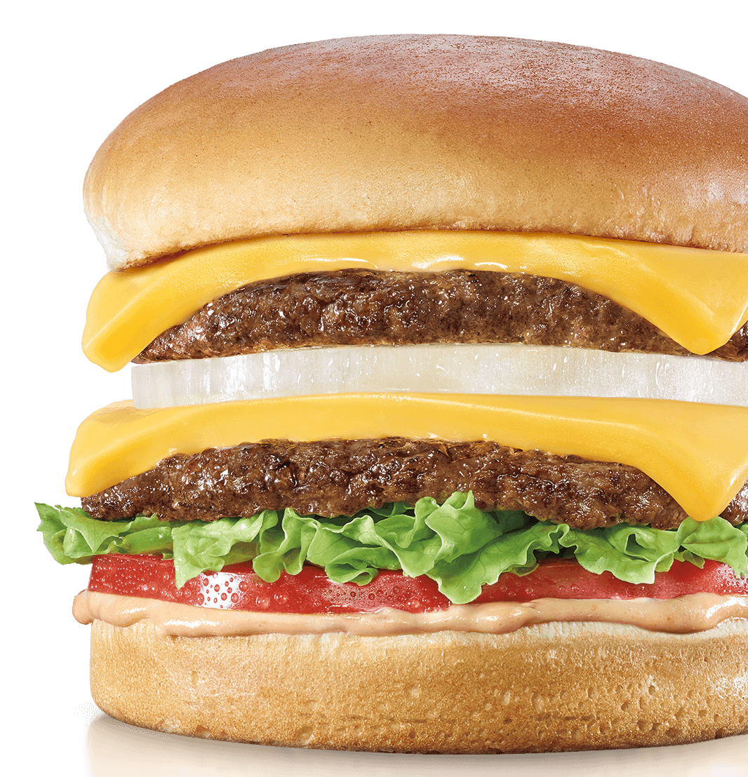
What Makes a Burger?
Buns
Patty
Lettuce
Cheese
Tomatoes
Pickles
Ketchup
Mustard
Sometimes Fries

Slide 3
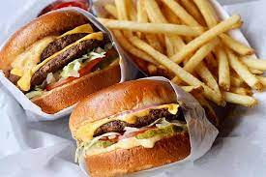
Where does the ingredients come from for the rest of the burgers?
Pickles come from Britain, Ireland, United States, Canada, Australia, Africa, and New Zealand
Buns come from England, Ireland, and Northern England
Lettuce originated in the Mediterranean area
Cheese originated from Kuyavia, Poland
Tomatoes are from South America and Central America.
Mustard comes from Canada, Montana, and North Dakota
French Fries come from Belgian

Slide 4
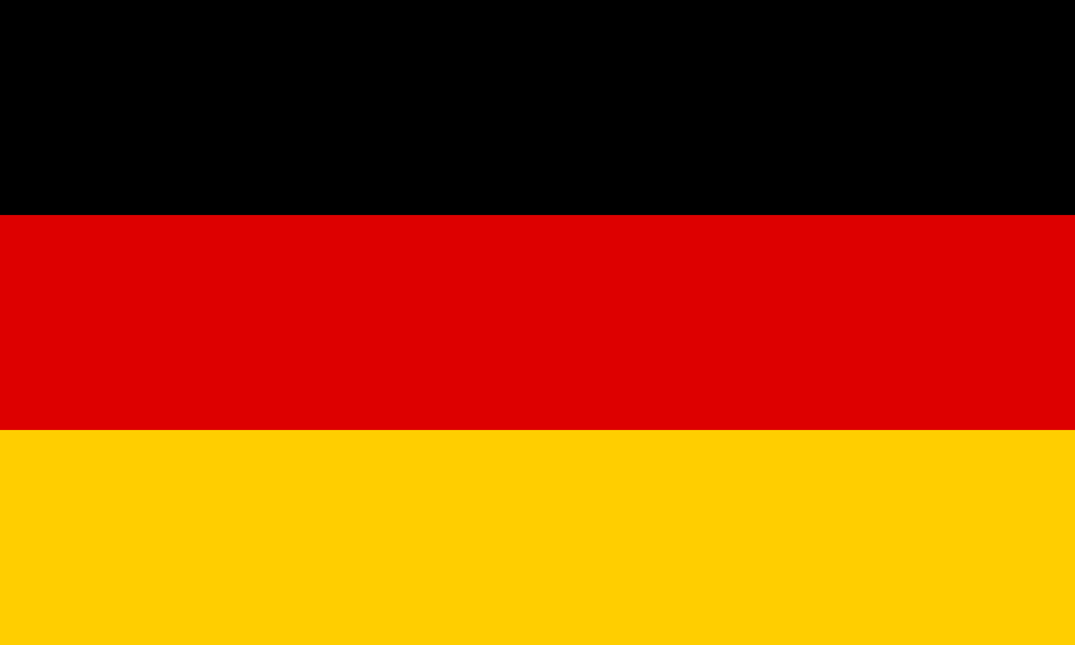
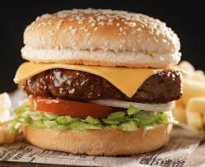
Where do burgers come from?
Germany

Slide 5
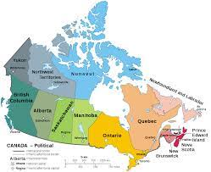
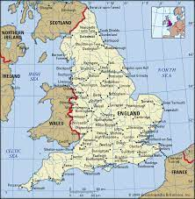
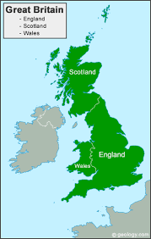
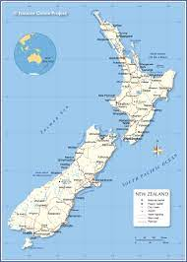
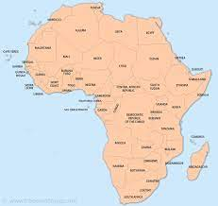
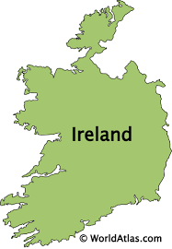
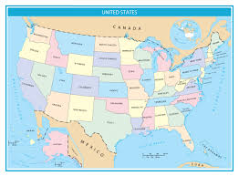
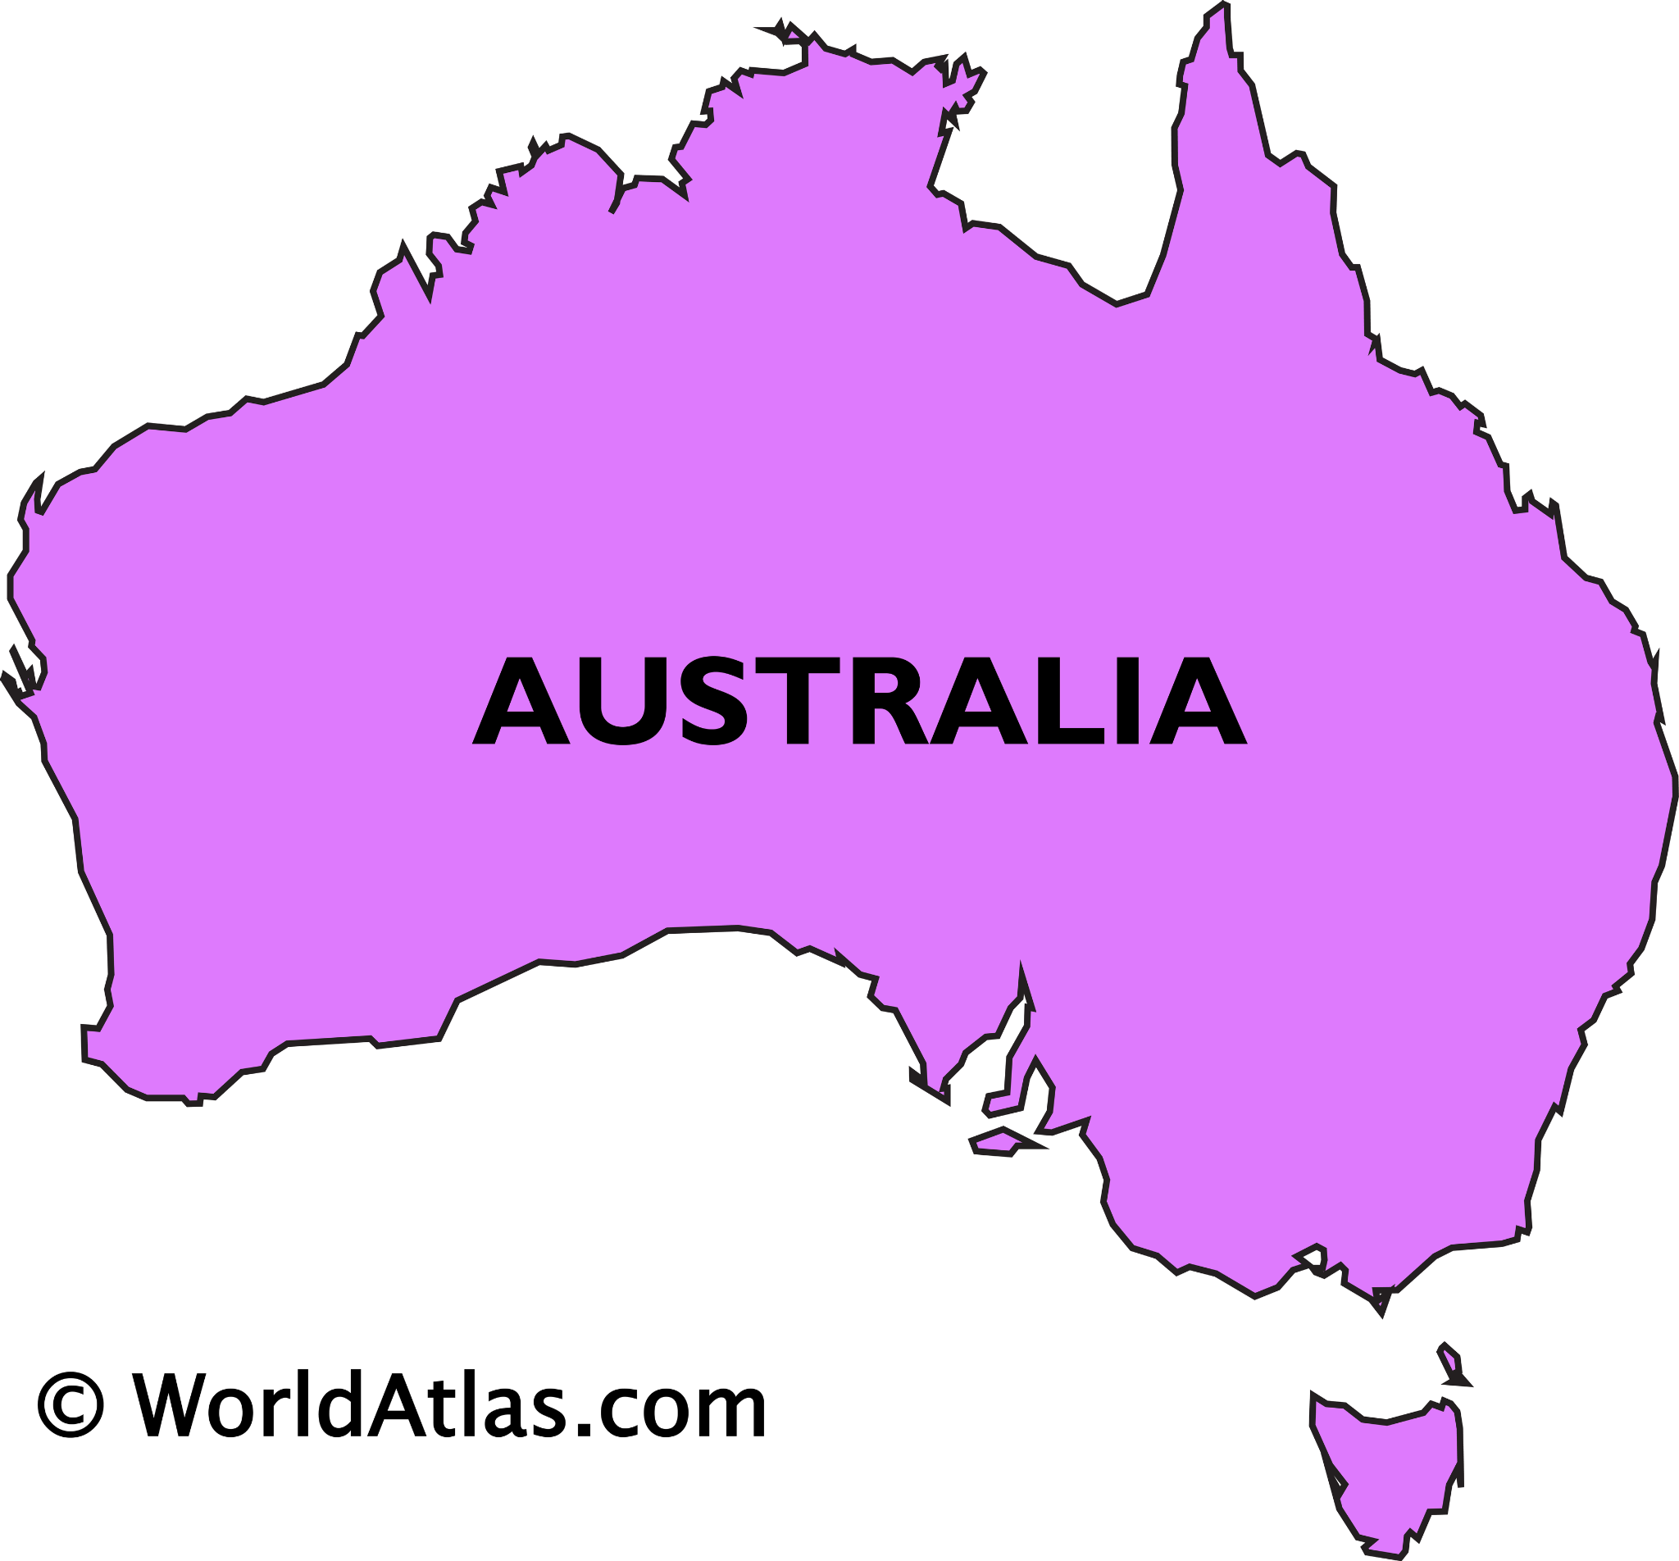
Map For Pickles
Pickles
Canada
England
Britain
Australia
Africa
Ireland
New Zealand
United States

Slide 6
Map For Buns
Buns
Ireland
England

Slide 7
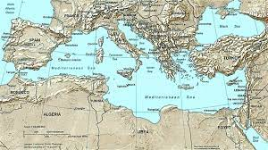
Map For Lettuce
Lettuce
Mediterranean area

Slide 8
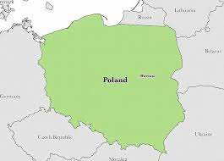
Map For Cheese
Cheese
Poland

Slide 9
Map For Tomatoes
Tomatoes
United States of America

Slide 10
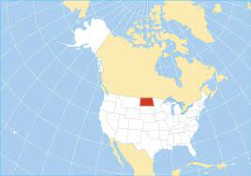
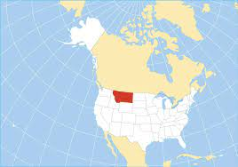
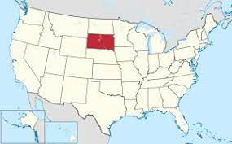
Map For Mustard
Mustard
Canada
North Dakota
South Dakota
Montana

Slide 11
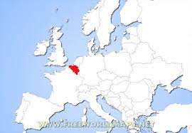
Map For French Fries
French Fries
Belgian

Slide 12
Essential Question: How does a product sourced from all over the planet reflect globalization?
Many people eat burgers every day
It provides them with fuel
It gives them protein
Globalization has led to an increase in supermarkets
Increasing access to processed and packaged foods
Increasing access to sugary beverages

Slide 13
Work Cited
https://www.in-n-out.com/menu/food-quality Pictures
http://www.volvodriver.com.au/foodhq/fastfood.htm Picture
https://bigseventravel.com/worlds-best-burgers/ Picture
https://www.lovefood.com/gallerylist/70068/the-best-burger-and-fries-joint-in-every-state Picture
Google Image Search More pictures
https://parade.com/61481/toriavey/where-did-hamburgers-originate/ Where burgers came from
https://en.wikipedia.org/wiki/Pickled_cucumber Pickles
https://en.wikipedia.org/wiki/Bun Hamburger Buns
https://dpi.wi.gov/sites/default/files/imce/school-nutrition/pdf/fact-sheet-lettuce.pdf lettuce

Slide 14
Continue Work Cited
https://www.hindustantimes.com/more-lifestyle/how-did-french-fries-get-their-name-here-s-all-you-need-to-know-about-the-world-s-most-favourite-potato-snack/story-7EhD7eDifk6Rd5k95jOHUK.html#:~:text=The%20origin%20story,they%20caught%20in%20the%20river. Picture of French fries
https://www.wonderopolis.org/wonder/what-is-mustard-made-of#:~:text=Mustard%20plants%20are%20grown%20all,other%20ingredients%20to%20make%20mustard Mustard
https://en.wikipedia.org/wiki/Tomato Tomatoes
https://www.britannica.com/place/England Map of England
https://www.freeworldmaps.net/printable/africa/ Map of Africa
https://gisgeography.com/united-states-map-collection/ United States Map
https://www.nationsonline.org/oneworld/map/new-zealand-map.htm Map of New Zealand
https://www.worldatlas.com/maps/ireland Map of Ireland
https://geology.com/world/british-isles.shtml Map of Britain
https://en.wikipedia.org/wiki/Provinces_and_territories_of_Canada Map of Canada
https://en.wikipedia.org/wiki/List_of_Mediterranean_countries Map of the Mediterranean area
https://www.schengenvisainfo.com/news/poland-commences-sanitary-inspections-at-eastern-borders/ Map of polland
https://en.wikipedia.org/wiki/South_Dakota Map of South Dakota
https://www.nationsonline.org/oneworld/map/USA/north_dakota_map.htm Map of North Dakota
https://www.ncbi.nlm.nih.gov/pmc/articles/PMC3401093/ Essential Question
https://www.worldatlas.com/maps/australia Map of Australia
https://www.freeworldmaps.net/europe/belgium/location.html Map of Belgian

